Slide 1





Cloud Funcions
Cloud Functions
The Interdisciplinary center for Smart Technologies
Faculty of Computer Science, Technion
by: Najeeb Abu Kheit

Slide 2
Cloud Funcions
Table of contents
🌟 Introductions
🛠️ Setup
🔢 ESP32 Button Counter
☁️ Cloud Functions and Cloud Messaging
📱 Flutter and Cloud Functions

Slide 3


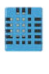
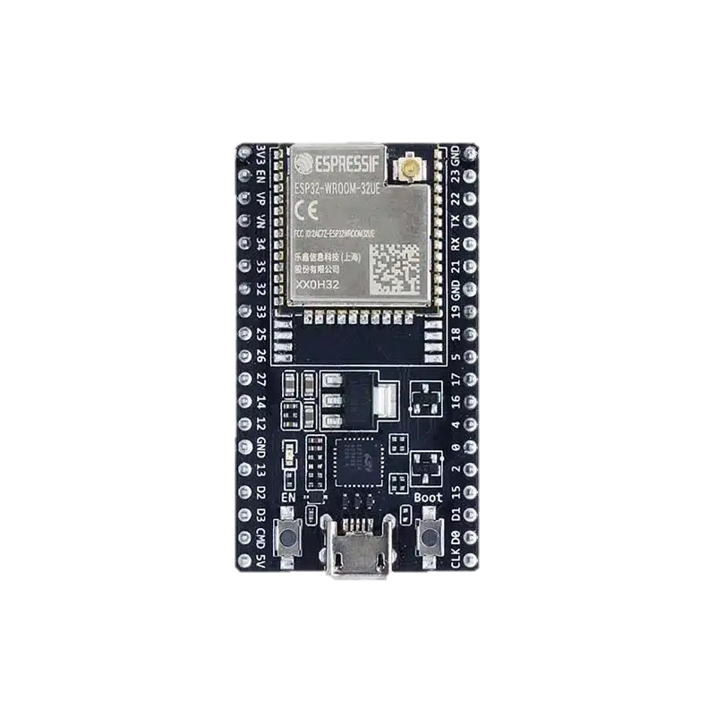
Cloud Funcions
Why cloud functions?
?
Humidity sensor
Notes:
Performance improvement for esp32 devices automate functions

Slide 4





Cloud Funcions
Realtime Database
Cloud messaging
Authentication
Storage
Cloud Functions
Notes:
Cloud function can communicate with all the firebase services and this is the key feature that this platform offers, this is what actually enable the firebase to make all the calculation needed and all the data needed straight out of the databases needed, without the need to make on device calls for data and calculations.

Slide 5



Cloud Funcions
Setup:
Firebase app initiallizing
Cloud function setup in firebase
Firebase CLI setup
Cloud function deployment

Slide 6

Cloud Funcions
Setup:
Firebase app initiallizing
Cloud function setup in firebase
Firebase CLI setup
Cloud function deployment

Slide 7
Cloud Funcions
Setup:
Firebase app initiallizing
Cloud function setup in firebase
Firebase CLI setup
Cloud function deployment

Slide 8
Cloud Funcions
Setup:
Firebase app initiallizing
Cloud function setup in firebase
Firebase CLI setup
Cloud function deployment

Slide 9
Cloud Funcions
Setup:
Firebase app initiallizing
Cloud function setup in firebase
Firebase CLI setup
Cloud function deployment

Slide 10

Cloud Funcions
Now that we saw how to setup our cloud functions environment lets see some use cases for cloud functions

Slide 11
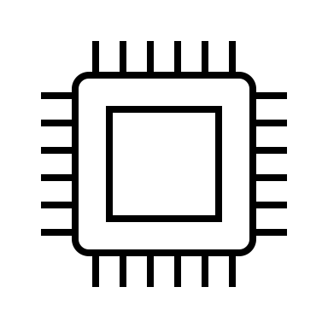

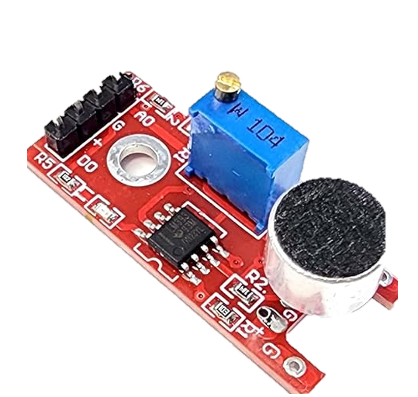


Cloud Funcions
ESP32 & cloud function
If loud noise detected 3x times in the same hour after 2 am
2:00 AM
Noise detector
To the parents
Notes:
This process of monitoring the noises, keeping track of time and resenting counter when needed, and sending a message using cloud message while monitoring the loud noises can be too much work for the esp32

Slide 12
Cloud Funcions
ESP32 & cloud function
solution
- Setup realtime database to monitor and log in noises data
- Setup cloud messaging service for this project
Create a new cloud function that will handle the logic of checking if the baby made a loud noise three times in the last hour and send a message to the parents if so.
Deploy the function and test the outcome.

Slide 13
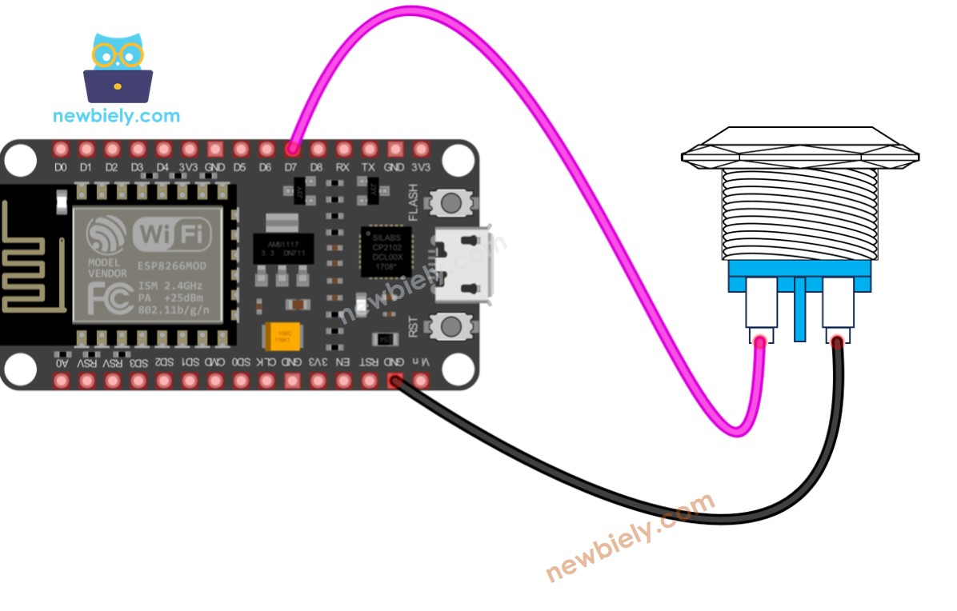
Cloud Funcions
ESP32 & cloud function
For today’s tutorial
A button is connected to our esp32 and a counter is being updated each time the button is clicked in the realtime-database. We will define a function that translate number from 1-100 to words, this function will be triggered each time that the button gets pressed and the results will be shown on the esp32 serial reader (or instead on a connected led screen).

Slide 14

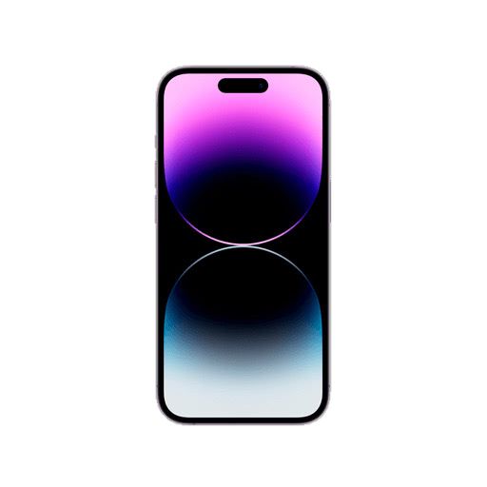
Cloud Funcions
Flutter & Cloud Function integration
Cloud Functions
New user just signed up
New welcome screen for new usersm include guides and so onm for first time users
WELCOME

Slide 15

THE END

Slide 16
Cloud Funcions

